Slide 2
Extra Slides

Slide 3
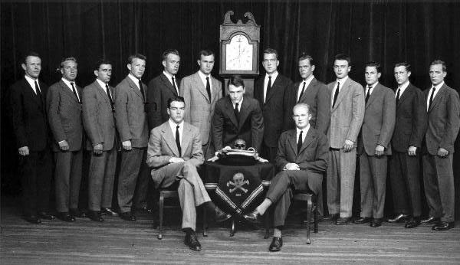
Course Overview
Skull and Bones a secret society that provides a type of identity to its members, can you spot George Bush?

Slide 4
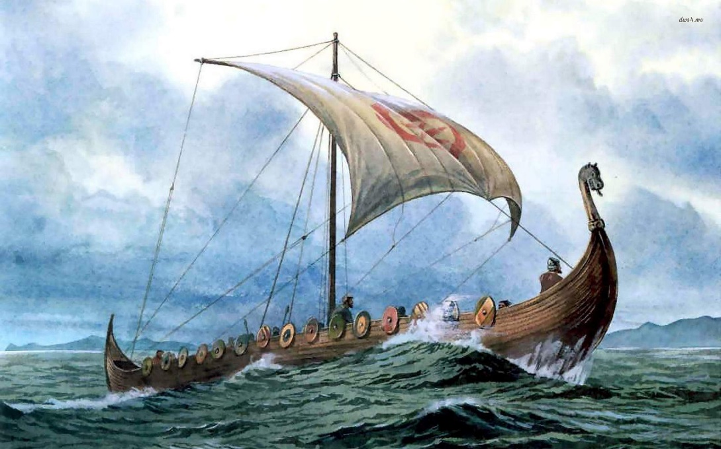
Literature Review and Previous Research
Social Identity Theory
Social environments (community, family, etc)
Cause Normative Behaviors
Self-Categorization- individual can categorize oneself as an object and be sort able into classifications
See groups as “us” and “them” often in psychology research see your group as superior
Viking raiders created a society where normative behavior felt raiding coastal settlements was a natural and “ok” function of society

Slide 5
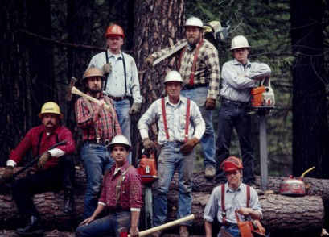
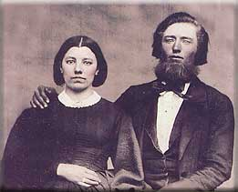
Theory Development
Can anyone name these independent, early American settlers?

